Slide 1
Week 3 - Selectors
QA Automation Course

Slide 2
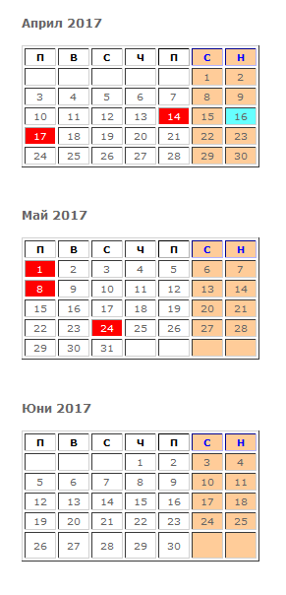
Should we move the course to Tuesday?

Slide 3
Homework review

Slide 4
What we’ll do today
CSS selector
Xpath selector

Slide 5
Last week selectors
By.ClassName
By.Id
By.Name
Example usage:
driver.FindElement(By.ClassName("map-search"))

Slide 6
Selectors
By.LinkText
By.PartialLinkText
By.TagName
By.CssSelector
By.XpathSelector

Slide 7
CSS selectors
https://saucelabs.com/resources/articles/selenium-tips-css-selectors; http://www.testingexcellence.com/css-selectors-selenium-webdriver-tutorial/
Search for “Selenium CSS examples”
Examples:

Slide 8
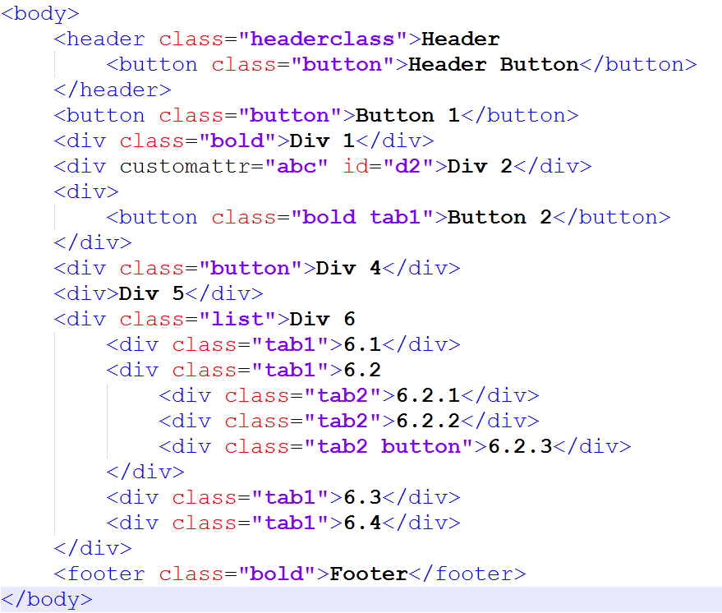
“header” element
“body header.headerclass”
“header.headerclass”
“.headerclass”
“6.2.3” element
“html body div.list div.tab1 div.tab2.button”
“.tab2.button”
Which elements is:
“div.button”
“.button”
“div.tab1”

Slide 9
Nth-of-type(n)
“div.list div:nth-of-type(2)” => 6.2
Nth-child
Last-child first child
#id
div#d2 => Div 2
element_name[<attribute_name>='<value>']
div[customattr=‘abc’]
Contains
*=
$=

Slide 10
Xpath selectors
https://www.w3schools.com/xml/xpath_intro.aspSearch for Selenium xpath examples
Examples

Slide 11
“header” element
“/html/body/header”
“//header[@class=‘headerclass’]”
“6.2.3” element
“/html/body/div/div/div[3]”
“//div[@class=‘list’]//div[5]”
. Matches current element
“/html/body” === “/html/./body”
* Matches any element
“/html/body/*[@class=‘bold’]”
“/html/body//*[@class=‘bold’]”
.. Matches parent element
“//*[@class=‘bold tab1’]/..”
Text() Matches parent element
“//*[text()=‘Div 2’]”

Slide 12
Demo (if we have time)
https://yavlenawebsite.melontech.com/properties/all/%D0%A1%D0%BE%D1%84%D0%B8%D1%8F%20(%D1%81%D1%82%D0%BE%D0%BB%D0%B8%D1%86%D0%B0)/%D0%A1%D0%BE%D1%84%D0%B8%D1%8F/?view=Hybrid
Expand “Тип имот“
driver.FindElement(By.XPath(
"//input[@placeholder='Тип имот']/../a[@class='dropdown-trigger']“
)).Click();

Slide 13
Conclusion
Use Ids whenever possible
Use css selectors
If you can’t find good other way – use Xpath

Slide 14
Homework
Choose number (5 digits)
Tsanka 67890
Aleks - ?????
Mitko 74352
Eva 10125
Dido 84111
Pesho 66666
Stefan 46305

Slide 15
Homework
https://yavlenawebsite.melontech.com/propertylist
Digit 1: Услуга
Digit 2: Тип имот
Digit 3: Вид имот
Digit 4+5: Област
Choose “Град“ that has some properties
Create a test that:
Opens the url
Clicks on the respective Услуга, Тип имот, Вид имот, Област, град depending on your number and choice of City
Click on “Свържи се с брокер” button for the (preferably) second property in the list
Commit and push the test

Slide 16
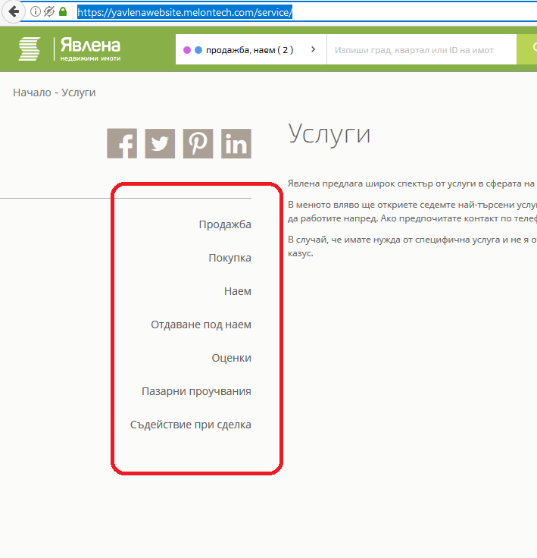
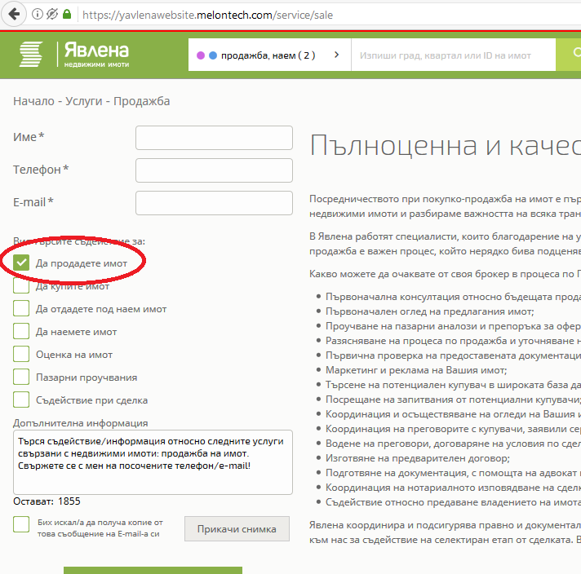
Homework 2
Open https://yavlenawebsite.melontech.com/service/
On the left there are links to different services
Everyone should click on a different service:
Tsanka Продажба
Aleks - Покупка
Mitko Наем
Eva Отдаване под наем
Dido Оценки
Pesho Пазарни проучвания
Stefan Съдействие при сделка
After clicking on the link for the service new webpage is opened. On the newly opened page make sure the correct checkbox is ticked: next to the service you chose in the previous screen

Slide 17
Q & A

